Slide 1
Concealed Data Practices and Competition Law: Why Privacy Matters
Dr Katharine Kemp
Senior Lecturer | Faculty of Law | UNSW Sydney

Slide 2
ACCC DPI Survey 2019 – consumer perceptions of misuse of personal information
Use for profiling and targeted advertising: 77%
Combining with data from other companies: 81%
Keeping track of online behaviour: 82%

Slide 3
Your personal information is important to us
We are subject to the requirements of the Privacy Act 1988 (Cth).
We respect the importance of your privacy, and that you have a right to make your own choices about how your personal information is collected and used. We know that when you provide personal information to us you are showing your trust and we take that seriously.
…

Slide 4
…
This may include us or our service providers … performing market research and analysis to better understand your preferences and interests, to help identify products and services that may be of interest to you …
We may also share your personal information with … someone with whom we share some common commercial interest.
…
You consent to the third parties to whom we disclose your personal information as described above using and disclosing that information as we may in accordance with this Privacy Policy.

Slide 5
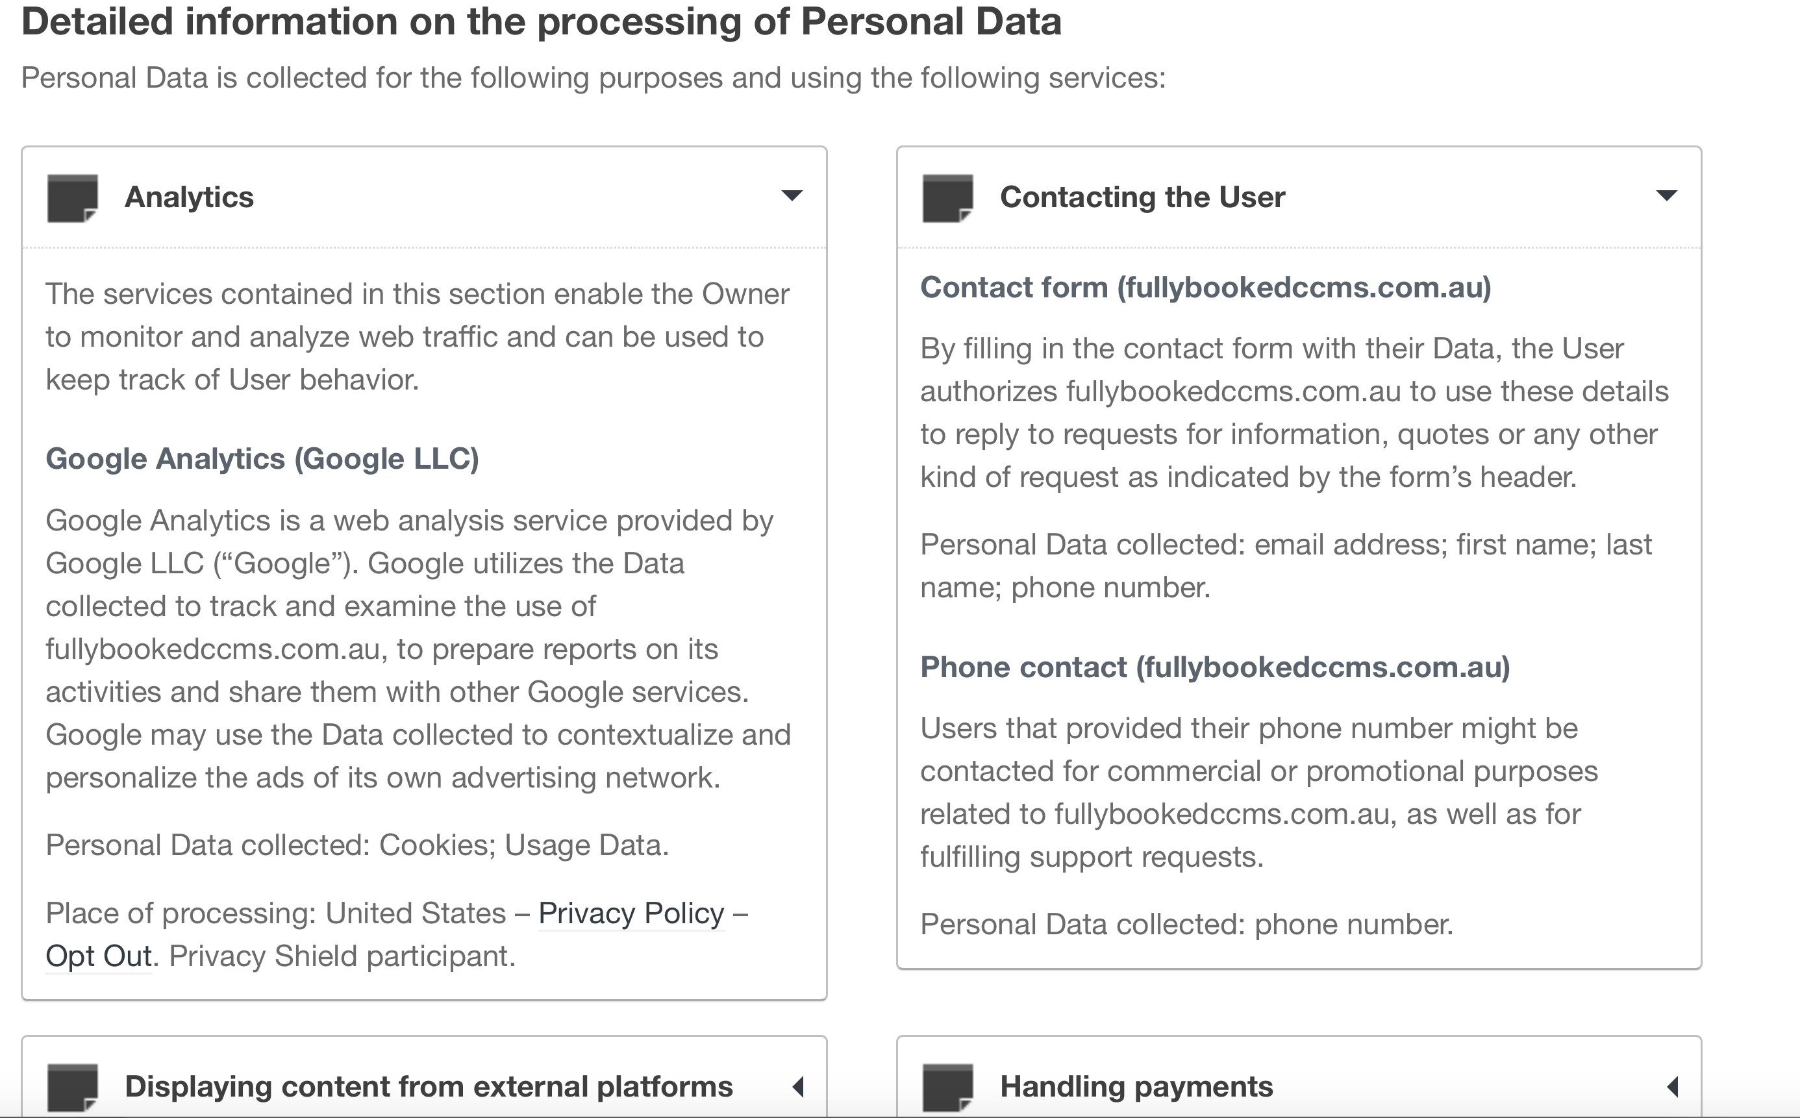

Slide 6
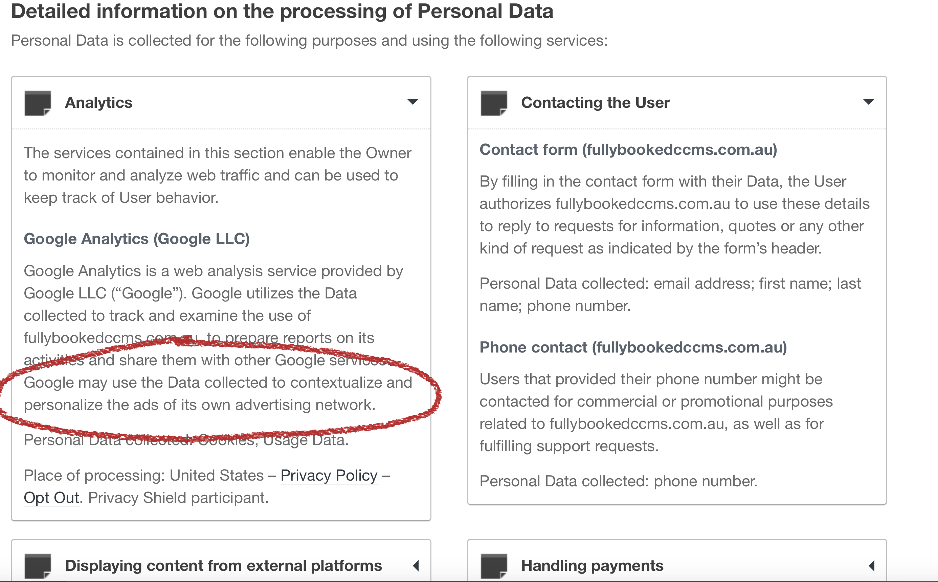

Slide 7
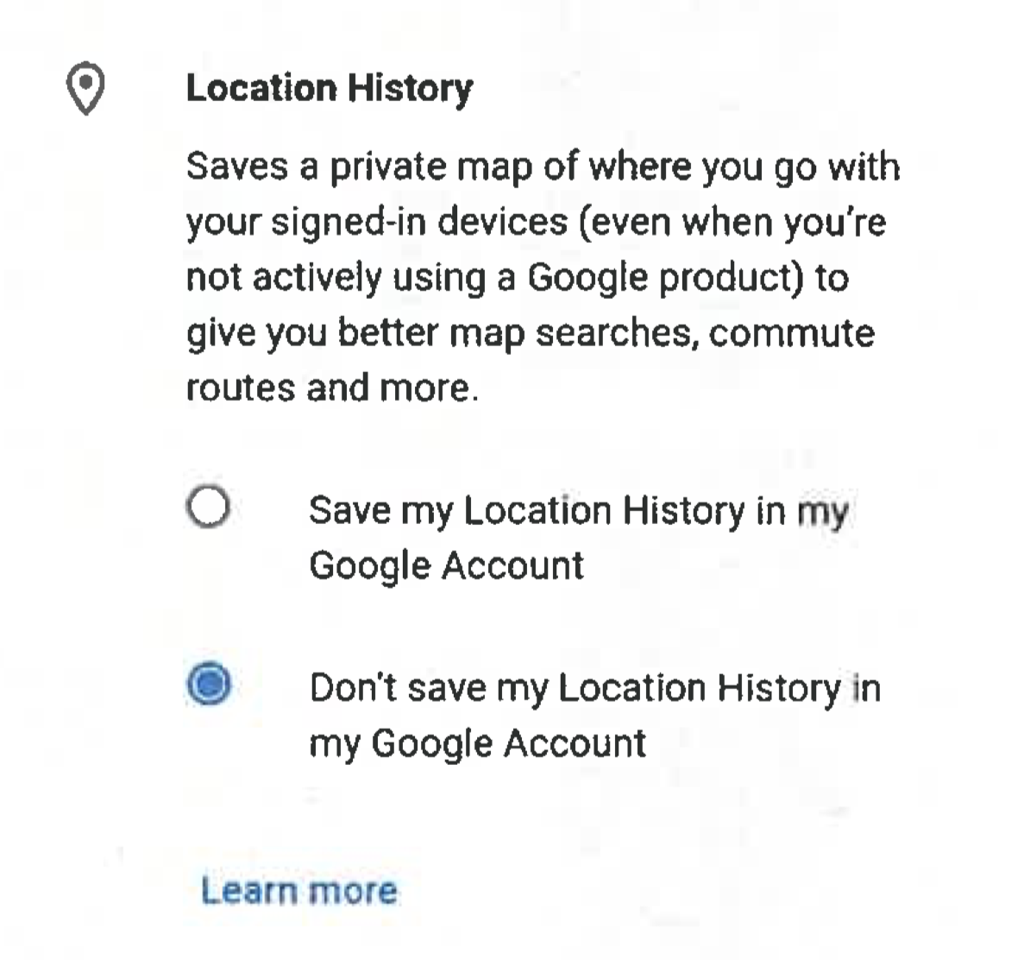
ACCC v Google

Slide 8
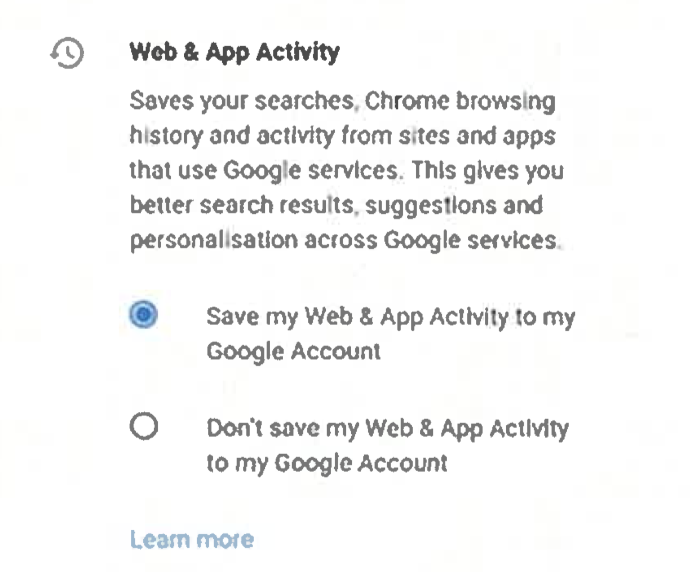
ACCC v Google

Slide 9
“Concealed data practices” occur when suppliers’ terms provide weak privacy protections for consumers while the extent of those terms, the resultant data practices and the consequences of these data practices are concealed from consumers.
Katharine Kemp, “Concealed Data Practices and Competition Law: Why Privacy Matters” (2019, UNSW Law Research Series)

Slide 10
Objective detriments to consumers
Increasing the “attack surface” and resultant risks of hacking, accidental disclosure and illegal use of personal information.
Disclosure of personal information the consumer does not wish to disclose.
Personal information used to discriminate, manipulate and exclude.

Slide 11
Manipulation by targeting vulnerabilities
“Dark patterns that manipulate individuals by targeting certain sorts of vulnerabilities are particularly troubling. Examples of the sort of behavior include the targeting of advertisements based on acute emotional vulnerabilities, such as the recent death of a child, or on specific health-related vulnerabilities, such as those related to episodes of mania or depression, as well as techniques tailored to exploit vulnerabilities of particular social groups. A person who struggles with bipolar disorder may be susceptible to impulse purchase during a manic episode.”
(Stigler Committee on Digital Platforms, Privacy and Data Protection Subcommittee Report, July 2019, p 240)

Slide 12
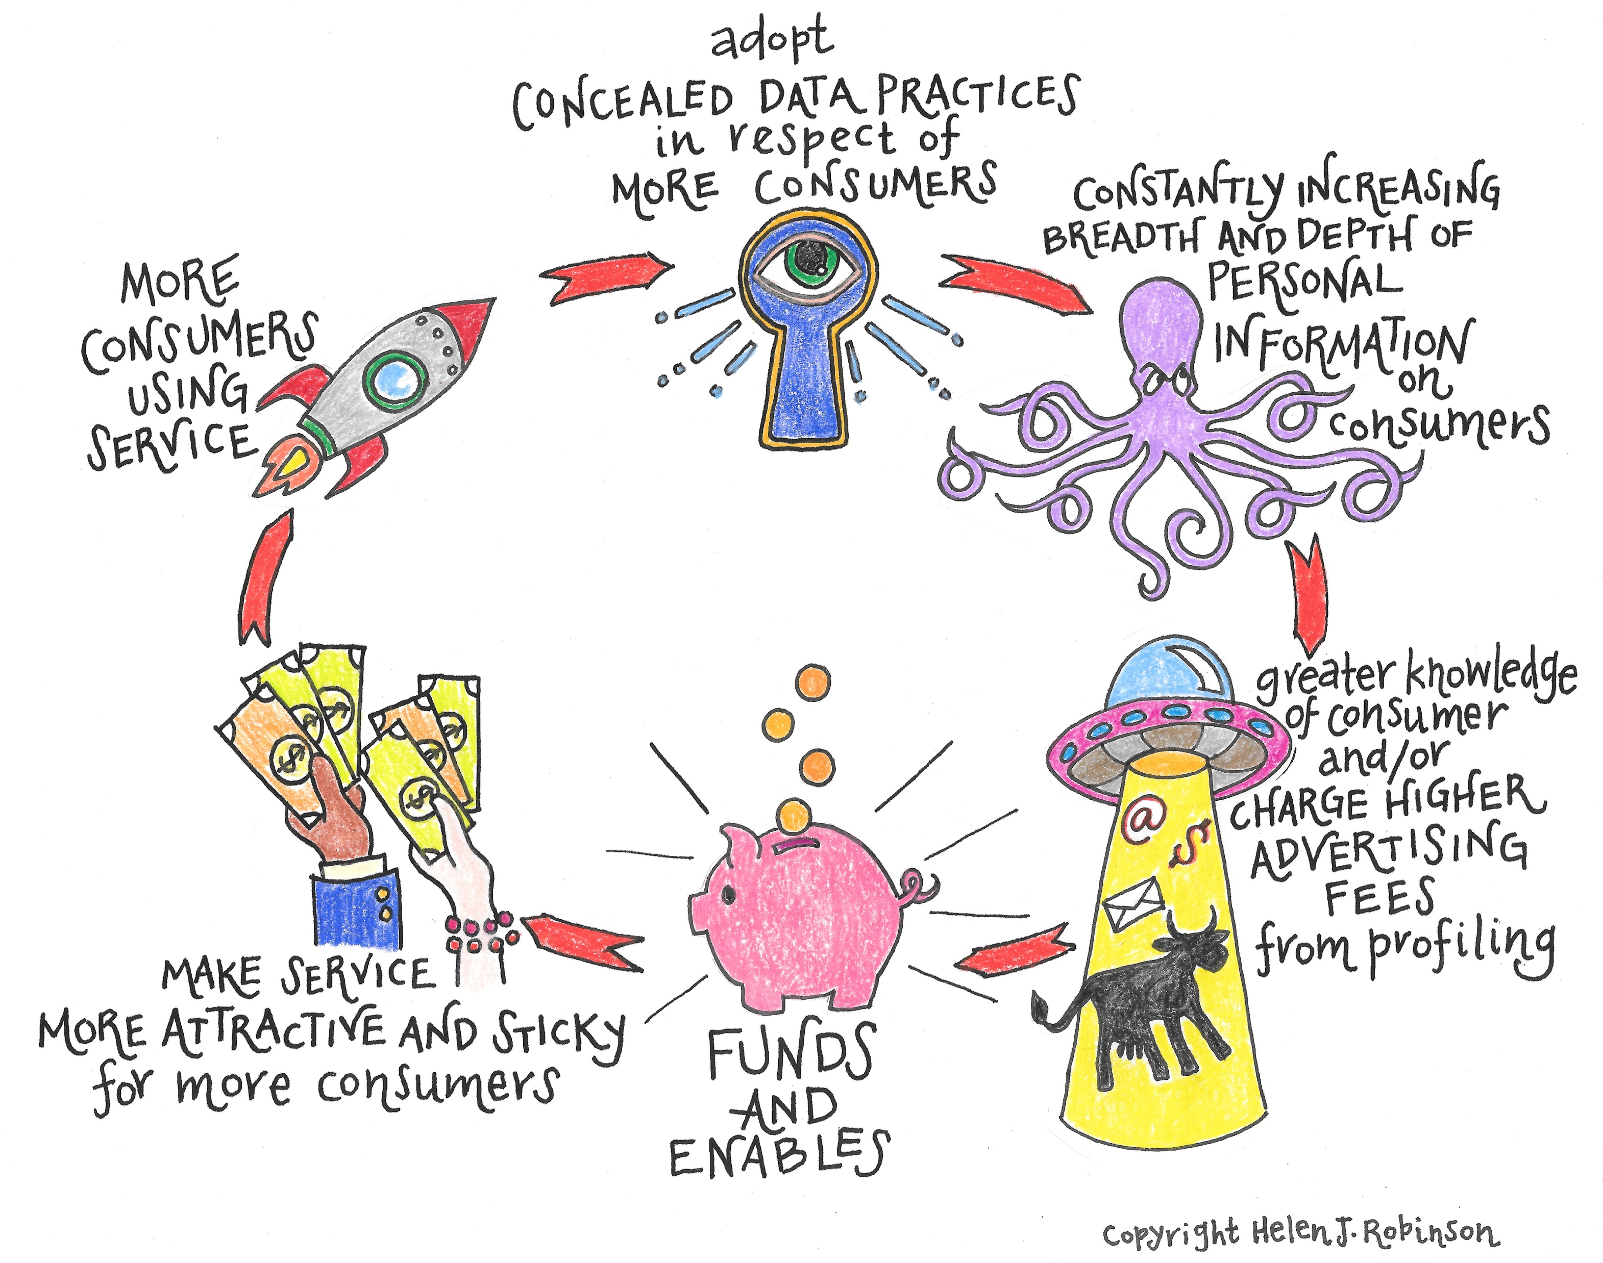
‘Concealed Data Practices and Competition Law: Why Privacy Matters’

Slide 13
Significance for competition authorities
Where concealed data practices are present, it should not be assumed that consumers have revealed a preference for the data privacy terms on which the relevant products are provided.
Diminished competition on privacy quality as a result of concealed data practices should be taken into account in any assessment of the state of competition, and market power, in any relevant market.
Where there is limited competition on privacy quality in a market as a result of concealed data practices, a further restriction on privacy competition may more readily amount to substantially lessening competition (SLC).
Investigations of conduct alleged to suppress privacy competition provide may have the beneficial side effect that the competition authority acts essentially as an expert intermediary, interpreting the state of privacy competition.

