Slide 1
Productivity and pay: Developments & issues in labour’s share of income gains
Workplace Relations Lecture Series
Fair Work Commission
Centre for Employment & Labour Relations Law
Melbourne, 16 August 2013
Dean Parham
Deepa Economics
parham.dean@gmail.com

Slide 2
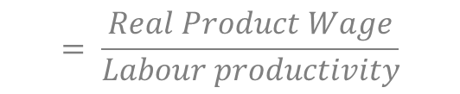
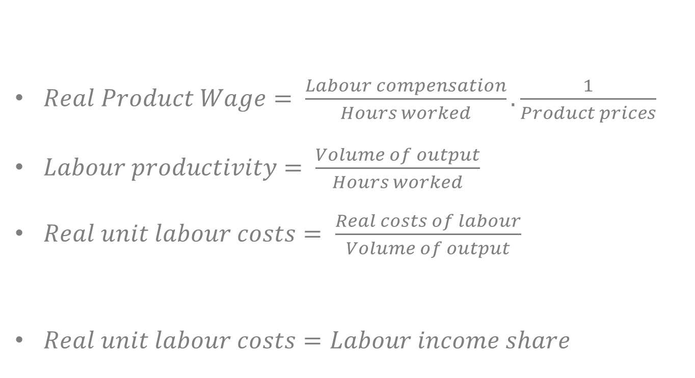
Definitions
$Real Product Wage= \frac{Labour compensation}{Hours worked}.\frac{1}{Product prices}$
$Labour productivity= \frac{Volume of output}{Hours worked}$
$Real unit labour costs= \frac{Real costs of labour}{Volume of output}$
$Real unit labour costs=Labour income share$
$$= \frac{Real Product Wage}{Labour productivity}$$

Slide 3

Takeaway
$Growth in LIS=growth in RPW −growth in LP$
$LIS ↓ when growth in RPW <growth in LP$
$LIS↑ when growth in RPW >growth in LP$

Slide 4
Rule of thumb
LP growth a benchmark for real wage growth
Increases in nominal wages has regard to growth in labour productivity and inflation
When growth in real wages above growth in LP
  raises real production costs
    reduces competitiveness
    pressure to reduce employment
When growth in real wages below growth in LP
  reduces real production costs
    improves competitiveness
    conducive to employment growth
  question of fairness – equitable share of productivity gains

Slide 5
The terms of trade lifted income growth above output growth in the 2000s
% growth since 1959-60
index
2010-11=100
Data source: ABS national accounts

Slide 6
The terms of trade filled the gap in average income growth left by slower productivity growth
% growth
since 1993-94
index
2010-11=100
Data source: ABS national accounts

Slide 7
Takeaways
Continued strong growth in prosperity in the 2000s
A surge in the terms of trade ‘filled a gap’ left by slower growth in productivity
The terms of trade had a major influence on the growth in real income and rate of improvement in living standards

Slide 8
The fall in the labour income share
4+ percentage points over the 2000s
How did this fall come about?

Slide 9
No shrinkage in labour income growth
% per year
Source: Parham (2013) forthcoming

Slide 10
Stronger output price inflation, not slower wage growth
% per year
Source: Parham (2013) forthcoming

Slide 11
Terms of trade drove a wedge between product prices and consumer prices
index
1999-00=100
Source: Parham (2013) forthcoming

Slide 12

Real consumption wage
$RCW= \frac{Nominal average hourly wage}{Consumer prices}$

Slide 13
Growth in RPW fell behind LP growth. RCW did not
% per year
Source: Parham (2013) forthcoming

Slide 14
Implications for the rule of thumb
Not a problem for producers
  competitiveness
What about fairness?
  real consumption wage is relevant
  growth in RCW kept up with, and surpassed, growth in LP

Slide 15
Sources of the fall in labour income share
Additional growth in income
  40% in mining
  25% in construction
Manufacturing lost the most share of income
Mining explains the entire fall in the labour income share
  Other industries much smaller and offsetting contributions

Slide 16
Mining essentially explains it all
% pt contributions
Source: Parham (2013) forthcoming

Slide 17
Implications for wage setting
Could wage rises be quarantined to the mining industry?
‘Headroom’ -- scope for wage growth within bounds of LP growth – essentially confined to mining
Prices variable, wages ‘sticky’ downward
Fairness of sharing resource rents with mining workers only
Fall in labour share is predominantly a ‘quantity’ effect – increased capital intensity – and not a price effect – profits v. wages
Basis for wage increases to raise labour share not clear

Slide 18
Looking forward
Labour income share likely to rise without any action
  Lower mineral export prices will raise RPW growth above LP growth
LIS will not fully revert
  Economy is more capital intensive
  Will thereby take a larger share of income
Growth in consumption prices greater than growth in product prices
  Growth in RCW less than growth in RPW
  Growth in RCW still in line with growth in LP??

Slide 19
Concluding remarks
Terms of trade had a large effect on income growth and the labour share of income
Need to take care with the usual ‘rules of thumb’ when there are shifts in the terms of trade
Need to distinguish between real wages as a cost to producers (RPW) and real wages as income to labour (RCW)
RPW the indicator re production efficiency criterion and RCW the indicator re fairness criterion
Focus on productivity growth to continue growth in living standards and to sustain growth in wages

